Slide 1

CANCER GENOMICS AND TREATMENT PREDICTION
ISHA PALIWAL
​School of Engineering & Applied Science, George Washington University

Slide 2

Agenda
CANCER GENOMICS AND TREATMENT PREDICTION
Introduction
Related work
our approach
Experiment results and Discussion
DATA COLLECTION
DATA DESCRIPTION CONTINUED….
DATA CLEANING & PREPROCESSING
EXPLORATORY DATA ANALYSIS
DATA ENCODING
MODEL DEVELOPMENT
VALIDATION
FINAL OBSERVATIONS
Conclusion
This Photo by Unknown Author is licensed under CC BY-SA

Slide 3

Introduction
CANCER GENOMICS AND TREATMENT PREDICTION
Cancer genomics is a field dedicated to understanding the genetic and molecular foundations of cancer, focusing on identifying genetic variations and mutations that drive cancer development and progression.
This project aims to explore a comprehensive dataset of genomic information to identify patterns, genetic markers, and correlations that could be critical in predicting cancer treatment outcomes.
Objective and Approach: The main objective is to leverage data-driven techniques to understand how genomic profiles can be used to predict cancer treatment outcomes, aiding in personalized treatment strategies. This involves statistical analysis, data visualization, and predictive modeling.

Slide 4

Related Work
CANCER GENOMICS AND TREATMENT PREDICTION
Deep Learning Methods for Drug Response Prediction: Drug response prediction (DRP) in cancer is an area where deep learning is showing significant potential. The general workflow for developing DRP models includes data preparation, model development, and performance analysis. Proper data preparation, such as feature representation and dataset partitioning, plays a crucial role in the success of these models. The development of neural network architectures involves the selection of modules, architecture, and learning schemes​ (https://www.frontiersin.org/articles/10.3389/fmed.2023.1086097/full)​.
Deep Learning in Cancer Diagnosis and Treatment Selection: Deep learning (DL) has emerged as a powerful tool for cancer diagnosis, prognosis, and treatment selection. Researchers are exploring explainability techniques to make DL models more transparent, aiding in resolving disagreements between clinicians and models.​ (https://genomemedicine.biomedcentral.com/articles/10.1186/s13073-021-00968-x)
Cancer Genomics for Transforming Diagnosis and Treatment: Genomic sequencing has revolutionized the way cancer is diagnosed and treated. By identifying specific mutations, oncologists can tailor targeted therapies to individual tumor profiles. A significant application of cancer genomics is in mesothelioma, where the evolution of somatic mutations is being studied to improve treatment strategies. The MEDUSA (Mesothelioma evolution: deciphering druggable somatic alterations) project aims to build predictive models to stratify existing therapies and identify new therapeutic vulnerabilities​ (https://www.nature.com/articles/d42473-022-00041-0)​.

Slide 5




OUR APPROACH
We utilized data from The Cancer Genome Atlas (TCGA), a comprehensive source of cancer biomarkers and clinical information, to predict outcomes in cancer treatment.
Key Objectives:
Forecast patient survival rates using “Vital Status."
Identify cancer stage through "AJCC Pathologic Stage."
Determine the “Treatment Type”, focusing on radiation therapy and pharmaceutical therapy.
To do this, we used “vital_status”, “ajcc_pathologic_stage”, and “treatment_type” as our target columns from the dataset.
Model Structure:
Implemented a Multioutput Classifier to address multiple target columns simultaneously.
Tested different base classifiers, including Naive Bayes (NB), Decision Trees (DT), Random Forest (RF), and Logistic Regression.
Approach to Model Selection:
Compared base classifiers to find the best model for our specific predictions.
Considered metrics like accuracy, precision, and recall to evaluate model performance.
CANCER GENOMICS AND TREATMENT PREDICTION

Slide 6


Experiment results and Discussion
CANCER GENOMICS AND TREATMENT PREDICTION
Objective:
Develop a robust model that enhances personalized cancer treatment by leveraging genomic insights.
6

Slide 7

Proposed Approach Overview
CANCER GENOMICS AND TREATMENT PREDICTION
Data CLEANING AND Preprocessing
EXPLORATORY DATA ANALYSIS
Model Development
Validation
Clinical Integration
Clean and standardize TCGA cancer data for analysis.
Identify patterns and potential biomarkers in the data.
Apply machine learning to predict treatment outcomes based on genomic profiles.
Test model accuracy with unseen data sets.
Translate model predictions into actionable treatment recommendations.
This step is a future step, and we have not worked on it.

Slide 8

DATA COLLECTION
CANCER GENOMICS AND TREATMENT PREDICTION
From the cancer genome atlas (TCGA), covering multiple cancer types.
https://portal.gdc.cancer.gov/analysis_page?app=Projects
DATASET DESCRIPTION
The Dataset used primarily focuses towards Breast Cancer Study and Analysis.
age_at_index: The age of the patient at the time of diagnosis or data collection.
ethnicity: Ethnic background of the patient.
gender: Gender of the patient, typically 'male' or 'female'.
race: The racial background of the patient.
vital_status: Indicates whether the patient is alive or deceased.
ajcc_pathologic_m: AJCC staging for metastasis, showing if cancer has spread to other parts of the body.
ajcc_pathologic_n: AJCC staging for nodes, indicating lymph node involvement.
ajcc_pathologic_stage: The overall stage of cancer according to the AJCC staging system.
ajcc_pathologic_t: AJCC staging for tumor, describing the size and extent of the primary tumor.
ajcc_staging_system_edition: The edition of the AJCC staging system used.
icd_10_code: ICD-10 diagnostic code for the condition or disease.
morphology: Describes the structure or shape of the tumor cells.
primary_diagnosis: The primary type of cancer diagnosis.
prior_malignancy: Indicates if the patient had any prior malignancies.

Slide 9
DATA DESCRIPTION CONTINUED….
prior_treatment: Indicates if the patient received prior treatment for cancer.
site_of_resection_or_biopsy: The site where tissue was removed for examination or biopsy.
treatment_or_therapy: Indicates if the patient underwent treatment or therapy.
treatment_type: The type of treatment the patient received (e.g., chemotherapy, surgery).
initial_weight: Initial weight of the patient at the time of data collection.
is_ffpe_x: Boolean indicating if the sample is formalin-fixed, paraffin-embedded (FFPE).
oct_embedded: Indicates if the tissue is embedded in Optimal Cutting Temperature compound.
sample_type: The type of sample collected (e.g., biopsy, blood sample).
specimen_type: The type of specimen obtained from the sample.
tissue_type: Type of tissue in the sample.
tumor_descriptor: Additional descriptor for the tumor.
portion_number: Number assigned to each portion of the specimen.
weight_x: Weight of the specimen or tissue.
analyte_type_clin: Type of analyte derived from the clinical sample.
extractable_dna: Indicates if DNA can be extracted from the sample.
aliquot_volume: Volume of the aliquot (sample portion).
concentration_samp: Concentration of a particular component in the sample.
percent_lymphocyte_infiltration: Percentage of lymphocyte infiltration in the tissue.
percent_monocyte_infiltration: Percentage of monocyte infiltration in the tissue.
percent_necrosis: Percentage of necrosis in the tissue.
percent_neutrophil_infiltration: Percentage of neutrophil infiltration in the tissue.
percent_normal_cells: Percentage of normal cells in the tissue.
percent_stromal_cells: Percentage of stromal cells in the tissue.
percent_tumor_cells: Percentage of tumor cells in the tissue.
percent_tumor_nuclei: Percentage of tumor nuclei in the tissue.
is_ffpe_y: Similar to "is_ffpe_x", indicating FFPE status of the sample

Slide 10
DATA CLEANING & PREPROCESSING
CANCER GENOMICS AND TREATMENT PREDICTION
Handling Missing Values:
Identify columns with significant missing values (>30%) and remove those that exceed the threshold.
Replace common obfuscated or incomplete values like '--', 'not reported', and 'unknown' with NaN for consistent handling.
Removing Duplicate Data:
Identify and drop duplicated columns to avoid redundancy.
Drop duplicated rows, keeping only the first occurrence to maintain data integrity.
Converting Data Types:
Identifying Outliers:
Calculate z-scores for numerical columns to identify outliers.
Remove rows with high z-scores (e.g., above a threshold of 3) to reduce data variability caused by outliers.
The dataset comprised of 159544 rows and 319 columns. After this extensive cleaning and preprocessing process, the data reduced to 125070 rows and 40 columns.
10

Slide 11
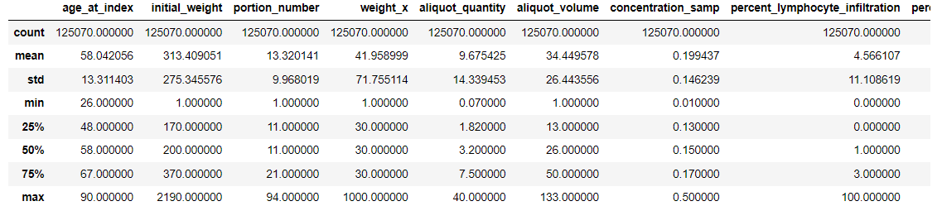
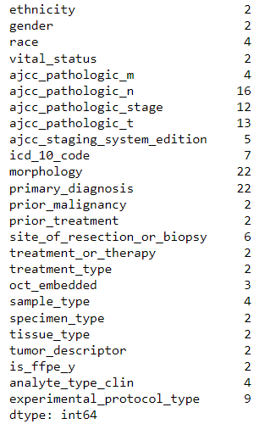
EXPLORATORY DATA ANALYSIS
Descriptive Statistics of Numerical Columns
Unique Values Count of Categorical Columns

Slide 12
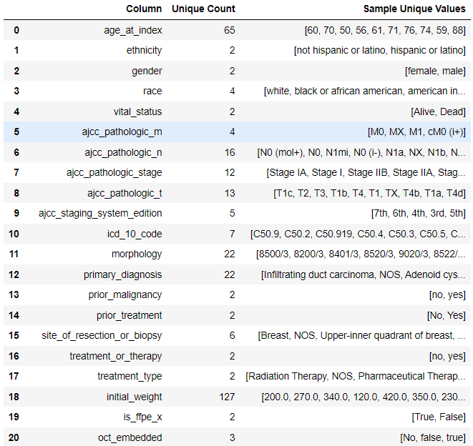
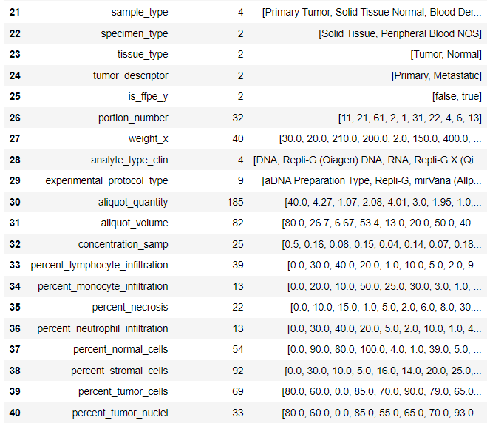
Data Summary

Slide 13
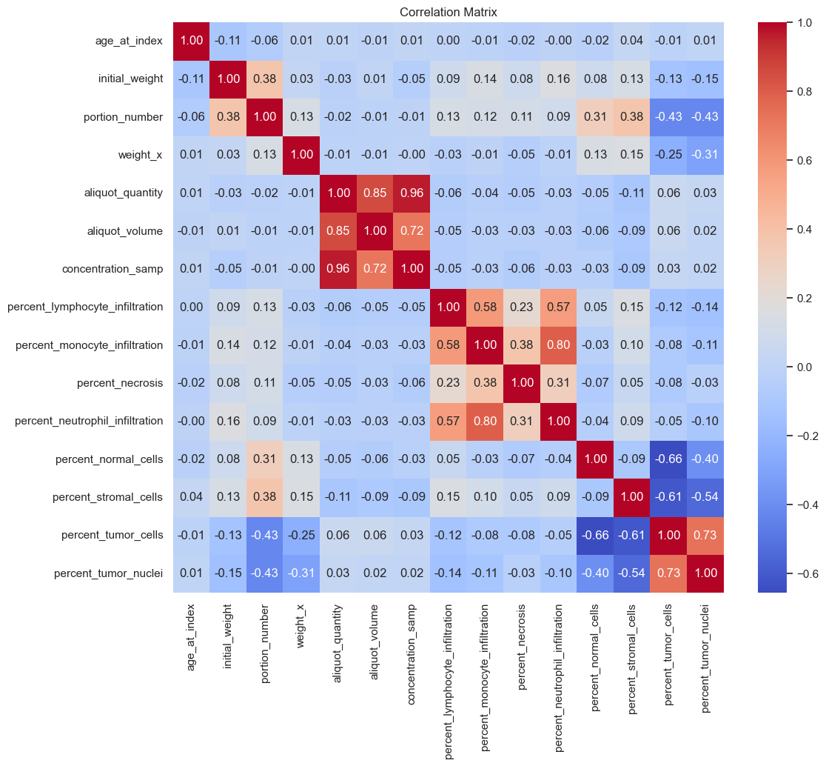
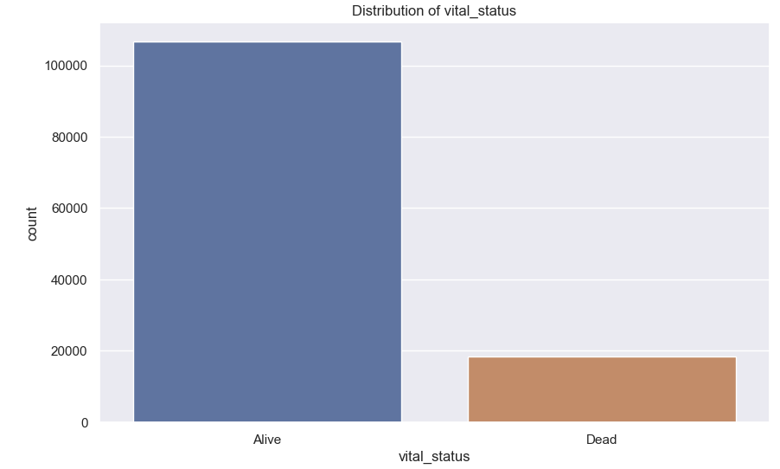
EXPLORATORY DATA ANALYSIS
Correlation Heatmap
Distribution of Target Column – Vital Status

Slide 14
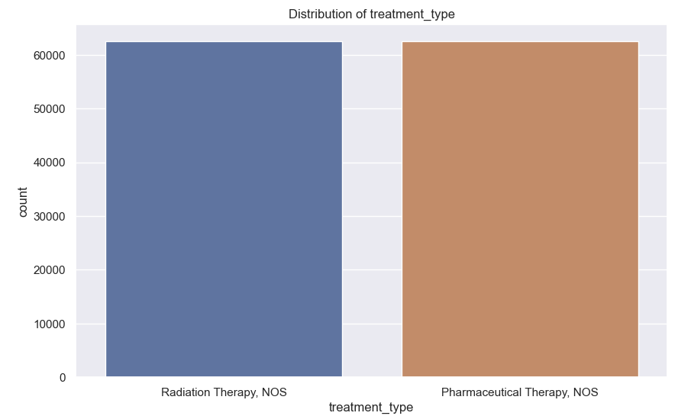
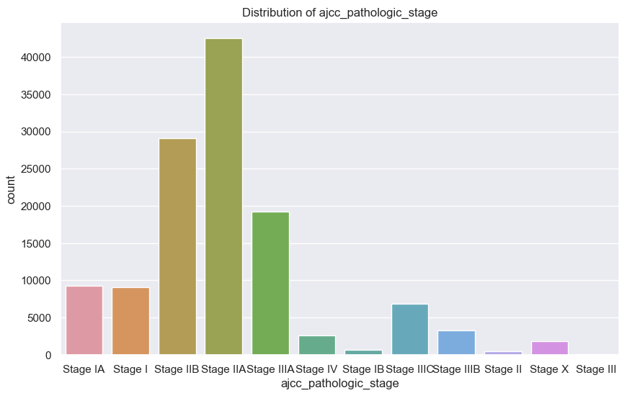
EXPLORATORY DATA ANALYSIS
Distribution of Target Column – Treatment Type
Distribution of Target Column – AJCC Pathologic Stage

Slide 15

DATA ENCODING
CANCER GENOMICS AND TREATMENT PREDICTION
Label Encoding:
Used ‘LabelEncoder’ to convert categorical variables into numerical format. This method assigns unique integers to each category, helping models interpret categorical data.
Ordinal Encoding:
Applied ‘OrdinalEncoder’ to assign ordered values to specific categorical columns, such as the AJCC Pathologic Stage, which follows a predefined order of cancer stages. This maintains the correct hierarchy within the encoded data.
One-Hot Encoding:
Implemented pd.get_dummies() to create dummy variables for non-ordered categorical columns. This technique converts each category into a binary representation, preventing misinterpretation of unordered categorical data by assigning a unique column for each category.

Slide 16
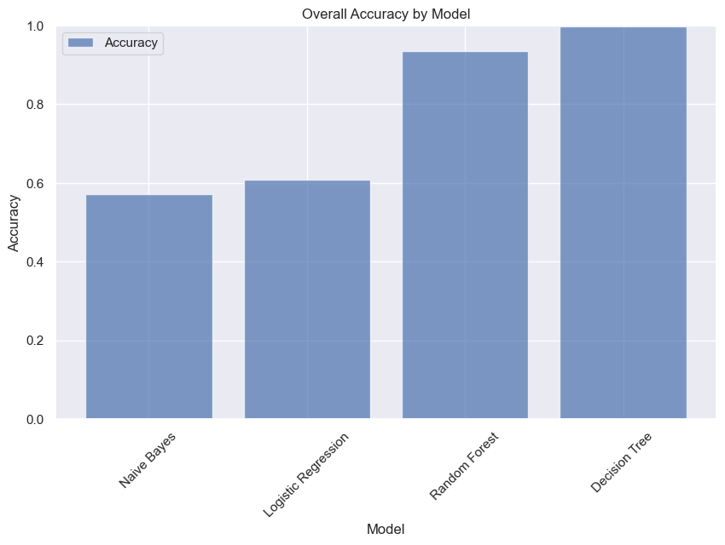
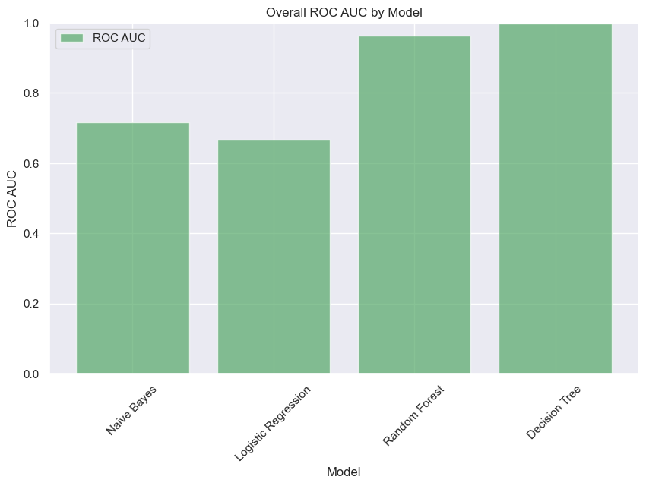
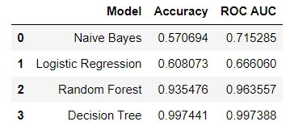
MODEL DEVELOPMENT
CANCER GENOMICS AND TREATMENT PREDICTION
Multi-Output Classification: Developed a MultiOutputClassifier to predict multiple target columns simultaneously, addressing the problem of correlated outputs in the dataset.
Base Classifiers: Implemented various base classifiers, such as Naive Bayes, Decision Trees, Random Forest, and Logistic Regression, to determine which yielded the best performance in the multi-output scenario.
Model Evaluation: Evaluated the models using key metrics like accuracy, and ROC AUC values. This approach helped identify the most effective base classifier for the specific prediction task.
Model Selection: After comparing the base classifiers' performance, the model with the optimal balance of accuracy, precision, and recall was selected for further development and tuning.
The Resultant Model Comparison Table
16

Slide 17

CANCER GENOMICS AND TREATMENT PREDICTION
VALIDATION

Slide 18
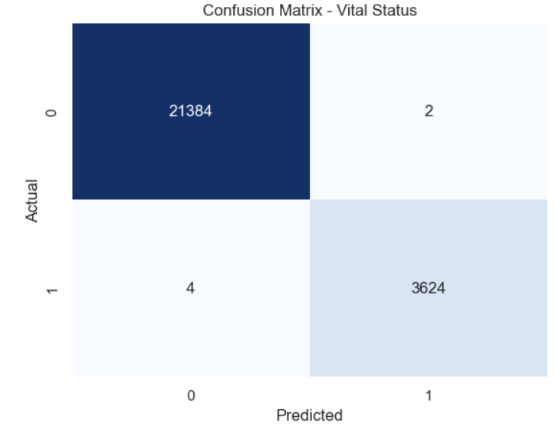
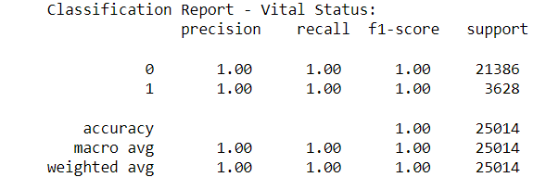

Selected Model - Decision Tree
For the target column - "Vital Status"
CANCER GENOMICS AND TREATMENT PREDICTION

Slide 19
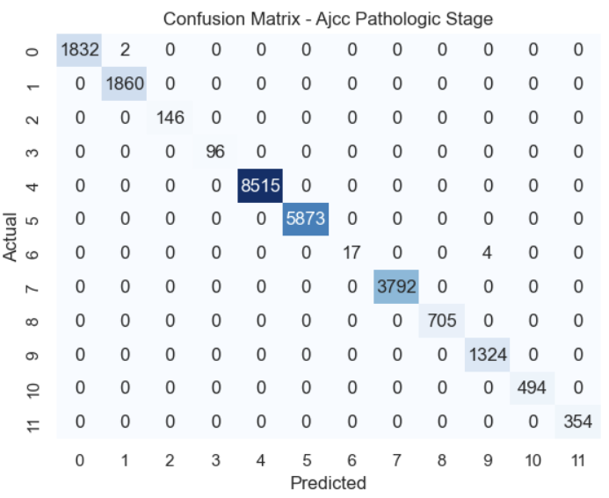
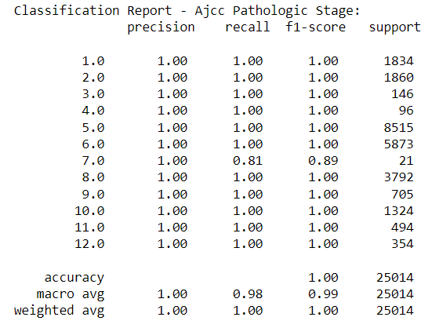

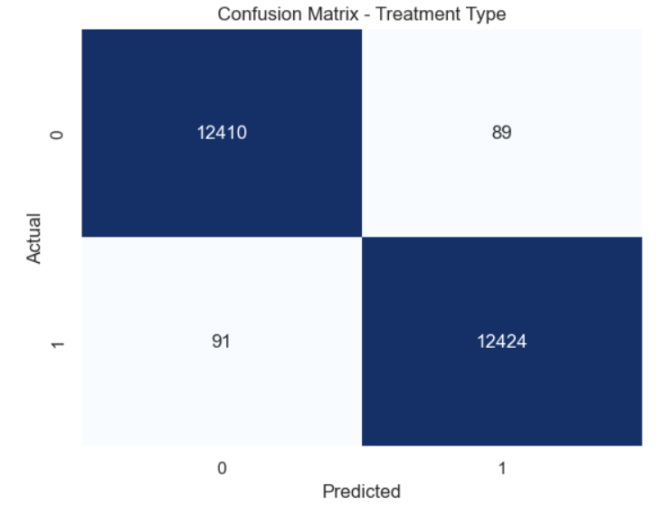
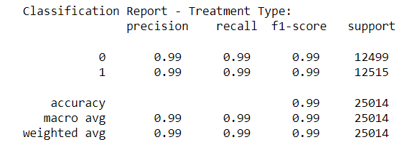
Selected Model - Decision Tree
For the target column - “AJCC Pathologic Stage"
CANCER GENOMICS AND TREATMENT PREDICTION
For the target column - “Treatment Type"

Slide 20

FINAL OBSERVATIONS
CANCER GENOMICS AND PERSONALIZED MEDICINE
Approach and Objectives: The project aimed to leverage data from The Cancer Genome Atlas (TCGA) to predict outcomes in cancer treatment using a multioutput classification approach. Key objectives included forecasting patient survival rates, identifying cancer stages, and determining treatment types.
Data Collection and Processing: Data was collected from TCGA, focusing on genomic information from various cancer types, with a specific focus on breast cancer. The initial dataset had 159,544 rows and 319 columns. After data cleaning and preprocessing, this was reduced to 125,070 rows and 40 columns. Techniques such as label encoding, ordinal encoding, and one-hot encoding were used for data transformation.
Model Development: The project explored multiple base classifiers, including Naive Bayes, Decision Trees, Random Forest, and Logistic Regression, to address multioutput classification. Key metrics like accuracy and ROC AUC were used to evaluate the models.
Validation and Model Selection: Decision Trees were chosen as the optimal model for the target columns, namely, "Vital Status," "AJCC Pathologic Stage," and "Treatment Type." Validation involved testing with unseen datasets to ensure the model's robustness.

Slide 21

CANCER GENOMICS AND TREATMENT PREDICTION
The project demonstrated a successful approach to predicting outcomes in cancer treatment using genomic data and machine learning techniques. By focusing on multioutput classification and implementing various data encoding and cleaning methods, the team achieved a robust model for personalized cancer treatment predictions.
Future work might include clinical integration to translate model predictions into actionable treatment recommendations. The results suggest that cancer genomics can play a critical role in tailoring personalized treatment strategies, contributing to the ongoing evolution of precision medicine.

Slide 22


Thank you
CANCER GENOMICS AND TREATMENT PREDICTION
22

Slide 23

QUESTIONS?
CANCER GENOMICS AND TREATMENT PREDICTION
23

